Slide 1
Encryption Based Steganography -
Modern Approach for Information Security
By :
    NIKET GOVIND 16MCA0019
    A BINDIAYA 16MCA0060
    MEERA 16MCA0008
Under the Guidance of :
PRABHU J
School of SITE

Slide 2
Contents
Abstract
Introduction
Problem statement
-Existing system
-proposed system
Algorithm
Example
Requirement Elicitation
-Functional requirements
-Non-Functional requirements
UML-Diagrams
-Use case diagram
-Sequence diagram
-State diagram
Conclusion

Slide 3
Abstract :
Steganography is the technique of hiding information so that any intermediate third party is unaware about the presence of secret message. Essence of steganography is that the third party should never be able to detect the presence of secret message in the cover image. Once the third party detects the secret message, it is assumed that the steganography technique has failed to serve its purpose. The proposed model presents a novel approach of develop a secure data hiding technique of Steganography using Some logical operations, binary convertor, along with random number generation method

Slide 4
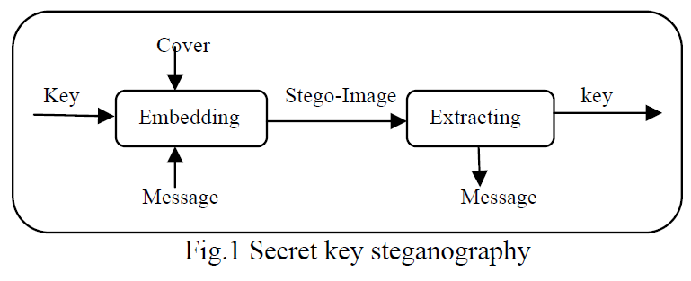
Cont..
a good technique of image steganography aims at three aspects
capacity
the maximum data that can be stored in cover image
Imperceptibility
The visual quality of stego-image after data hiding is not changed
Robustness
The system should give good result for complex values

Slide 5
Problem statement:
Existing system
There are many techniques are available like LSB algorithm and Patchwork algorithm but they have their own drawbacks like easiness of getting least significant bits of every pixel in least significant bit algorithm

Slide 6
Proposed System
Unlike in LSB this algorithm uses a key which contains the modified pixels of the cover image. This key is shared between the sender and receiver only
This project has three part
1.Message Encryption
2.Selection of cover image
3.Message embedded into cover image

Slide 7
Algorithm
Algorithm:
Encryption:
Step 1: Select secret information and image.
Step 2: Divide the information into three parts.
Step 3: Enter six digit key divide into three parts
Step 4: Do the operation for each part of key mod6+1
Step 5: Add first part result of key to first part of information and subtract
second part result of key to second part of information and third part
result of key to third part of information.
Step 6: Now we generate random pixels and sort the pixels in ascending order

Slide 8
Cont..
Step 7: Now we take all pixels RGB values and any one value of RGB values
greater than 150 then that pixel change as brighter pixel by adding RGB
values to cipher text.
Step 8: And all of RGB values less than 150 then that pixel is change as darker
pixel by subtracting RGB values from cipher text .
Step 9: Embed the all values into cover image.

Slide 9
conti....
Decryption:
Step 1: Take to two images stego image as well as original cover image.
Step 2: Check all pixels and get all modified pixels
Step 3: Now we get difference of original image RGB values to the stego
image RGB values.
Step 4: Now we get cipher text from stego image.
Step 5: Now we enter six digit key to decrypt the cipher text
Step 6: Now we get original information.

Slide 10
Example
4.2 Example:
Encryption:
step 1:enter secret message
GVP and take ASCII values are
G=71
V=86
P=80
step 2: Enter six digit key
123456
divide into three parts and do mod6+1 to each part
12%6+1=1
34%6+1=5
56%6+1=3
step 3: Add 1 to first part, subtract 5 to second part and add 3 to third part
we get
72
81
83
cipher text is HQJ

Slide 11
Cont…
step 4: Generate random pixels
193,161
254,231
68,251
step 5: Sort the pixels
68,251
193,161
254,231
step 6: Now we take RGB values for all pixels
68,251 193,161 254,231
R=50 R=60 R=40
G=70 G=150 G=30
B=155 B=170 B=50
step 7:Now we do
R=50+72=122%256=122 R=60+81=141%256=141
G=70+72=142%256=142 G=150+81=231%256=231
B=155+72=227%256=227 B=170+81=251%256=251
R=40-83=-42 G=30-83=-53 B=50-83=-33
255-43=212 255-53=202 255-33=222
step 8: Now we save the stego image and send it to Receiver.

Slide 12
Cont….
Decryption:
step 1: Browse the stego image and original image.
step 2: Check all pixels and get all modified pixels.
step 3: Now we calculate the difference of RGB values of original values to
the RGB values of stego image.
step 4:The difference in pixels is calculated as
72
81
83
step 5: Corresponding cipher text is HQJ
step 6: Now decrypt the cipher text with the same key 123456
step 7:Now we get original message GVP

Slide 13
Requirement Elicitation
Functional RequirementsEncryption :
Encryption
Input :
-plain text, Image
Output :
-Stego Image
Decryption
Input :
-Stego Image
Output :
-Plain text, Image

Slide 14
Hardware requirements:
Processor : Pentium IV and above
RAM : 1GB and above
Hard Disk : 40 GB and above
Input device : Standard Keyboard and Mouse
Output device : Standard Monitor
Software requirements:
Operating System : Windows XP and above
Programming language : Core Java(NetBeans IDE)

Slide 15
Non-Functional Requirements
Usability:
User having minimum idea of system can use the tool.
The interface of this system is GUI. The user interface could be user
friendly.
The users can easily use the system and the user interface could be
flexible
Reliability
The proposed system meets the user requirements. It provides
better result compared to other algorithms.
Robustness
This system functions in the presence of invalid inputs as
displaying message that to provide a correct details.

Slide 16
Performance
Response time
The system will takes less time to encrypt and decrypt
the plain text.
Availability
User can use the system anytime when needed.
Security
This System provides security by using discrete logarithm.

Slide 17
UML DIAGRAMS

Slide 18
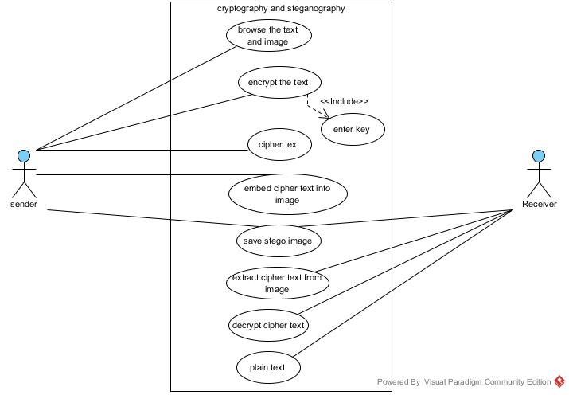
Use case diagram

Slide 19
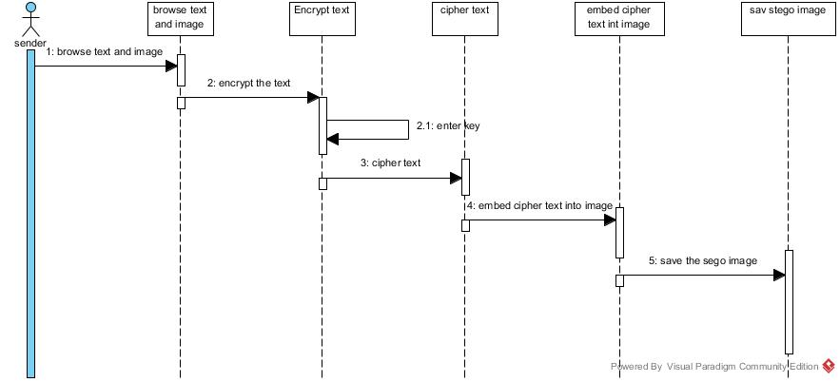
Sequence diagram for sender

Slide 20
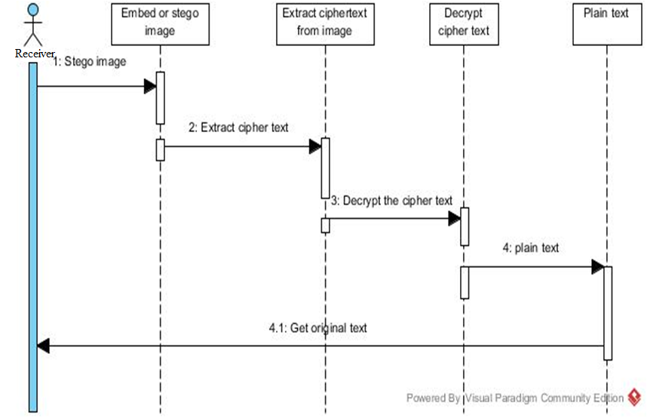
Sequence diagram for receiver

Slide 21
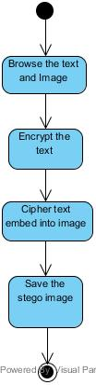
State chart diagram for sender

Slide 22
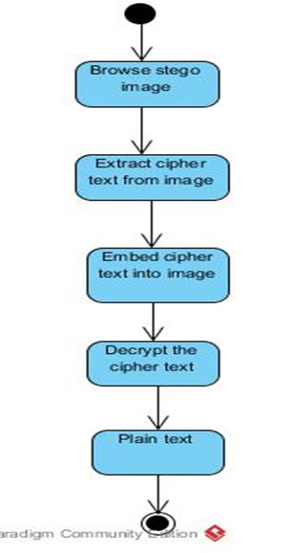
State chart diagram for receiver

Slide 23
conclusion
In this project a secure image steganography
technique is proposed to hide text images, which
also tells how to hide data bits. The experimental
results show that the technique produces good
quality stego images

Slide 24


